Slide 1





Missouri Commuter Analysis
Martin Carriel, Addison Pietroburgo, Joshua Steinmetz, Scott Stevener
Washington University Data Analytics Boot Camp
Fall 2018

Slide 2
Motivation & Summary
Hypotheses
H0 = No differences exist between commuting types in metro versus rural counties across Missouri.
H1 = Differences exist between commuting types in metro versus rural counties across Missouri, where usage of public transit in metro counties is higher.
Questions asked (and why you asked them?)
How do Missourians commute?
What differences exist for commuting types across counties in Missouri?
What differences exist for commuting types within metropolitan areas in Missouri?
(Describe whether you were able to answer these questions to your satisfaction, and briefly summarize your findings)

Slide 3
Questions & Data
How do Missourians commute?
What commuter trends exist across urban and rural parts of Missouri?
What differences exist for commuting types across counties in Missouri?
Are typical commutes similar or do the different metro regions commute in different ways?
Data Sources
US Census API
Wikipedia
Wikilou.com
MARC.org (Mid-America Regional Council)

Slide 4
Data Exploration & Cleanup
Describe the exploration and cleanup process
Discuss insights you had while exploring the data that you didn't anticipate
Discuss any problems that arose after exploring the data, and how you resolved them
Present and discuss interesting figures developed during exploration, ideally with the help of Jupyter Notebook

Slide 5
Data Analysis
Discuss the steps you took to analyze the data and answer each question you asked in your proposal
Present and discuss interesting figures developed during analysis, ideally with the help of Jupyter Notebook

Slide 6
Discussion
Discuss your findings.
Did you find what you expected to find? If not, why not?
What inferences or general conclusions can you draw from your analysis?
Driving to work alone is seem as the best option by the overwhelming majority of commuters.
Commuters do not have commuting options other than solo commuting.
Commuters do not see options other than solo commuting as a viable way to get to work.
The option to use public transit exists mainly in urban areas.
Even in urban areas where public transit is available, Missourians do not use it for commuting.

Slide 7
Post-Mortem
Metropolitan areas of Missouri range from nearly 3 million in population (St Louis) to around 150,000 (Columbia)
We chose to classify the three most densely populated areas “metro” or urban and all remaining counties as “rural”
Given additional time additional details to analyze include:
Find sources including time of commute
Find sources including distance of commute

Slide 8
Post-Mortem
Other data that could offer relevant information include:
Average commute type across urban and rural regions including age, education, and income data
We found that rural and urban regions of Missouri did not differ dramatically in commuting behavior.
Expanding this study to include additional states and regions of different sizes could provide different results

Slide 10
Definition of Commuting
Census surveys define Commuting (Journey to Work) as “a worker’s travel from home to work”.
Census surveys ask questions about Commuting such as travel time, means of transportation, time of departure for work, vehicles available, and expenses associated with the commute.
For this analysis we looked only at means of transportation

Slide 11
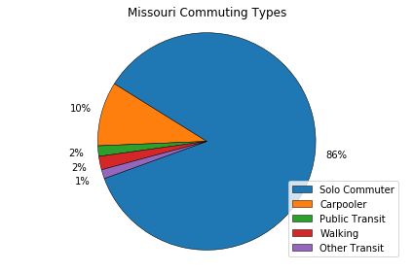
Statewide Analysis

Slide 12
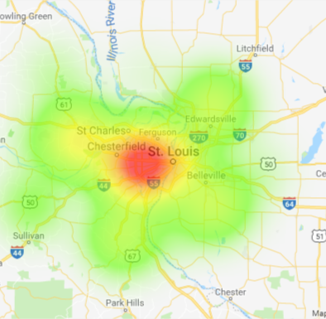
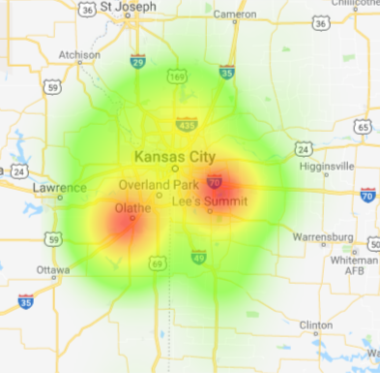
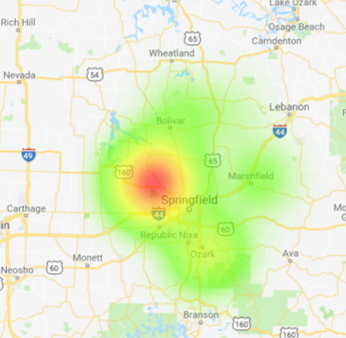
Heat Maps of MO MSAs

Slide 13
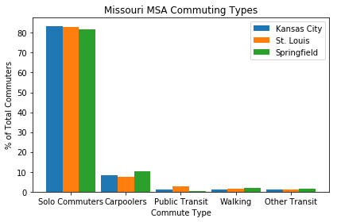
MSA Analysis

Slide 14
Hypotheses
H₀ ₌ No differences exist between commuting types in metro versus rural counties across Missouri.
H₁ = Differences exist between commuting types in metro versus rural counties across Missouri, where usage of public transit in metro counties is higher.

Slide 15
What we wanted to understand
How do Missourians commute?
What differences exist for commuting types across counties in Missouri?
What differences exist for commuting types within metropolitan areas in Missouri?

Slide 16
MSAs Analyzed
St. Louis
St. Louis City, MO
St. Louis County, MO
St. Charles County, MO
Jefferson County, MO
Franklin County, MO
Lincoln County, MO
Warren County, MO
Madison County, IL
St. Clair County, IL
Clinton County, IL
Monroe County, IL
Jersey County, IL
Kansas City
Bates County, MO
Caldwell County, MO
Cass County, MO
Clay County, MO
Clinton County, MO
Jackson County, MO
Lafayette County, MO
Platte County, MO
Ray County, MO
Johnson County, KS
Leavenworth County, KS
Linn County, KS
Miami County, KS
Wyandotte County, KS
Springfield
Greene County, MO
Christian County, MO
Webster County, MO
Polk County, MO
Dallas County, MO

Slide 18
Solo Commuters

Slide 19
Carpoolers

Slide 20
Public Transit

Slide 21
Walking

Slide 22

Other Transit

